Slide 1
TEK306: Sikkerhet i mobile applikasjoner
Exploiting Vulnerabilities and Writing Secure Android Applications

Slide 2
Contents
Reviewing Pre-Installed Applications
Exploiting Devices
Infiltrating User Data
Principle of Least Exposure
Essential Security Mechanisms
Slowing Down a Reverse Engineer

Slide 3
Reviewing Pre-Installed Apps
Its important to understand how an attacker uses an Android application vulnerabilities to gain access to devices.
  Finding vulnerabilities in pre-installed apps and exploiting them.
  Like testing other technologies, attacking phones is a part of security testing.
  The more you know how to compromise devices, the better chance you have to secure them.

Slide 4
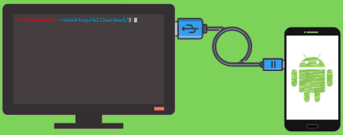
Reviewing …

Slide 5
Reviewing …
Each installed application has its own attack surface that can be explored.
Emphasis is placed on gaining root access to a device.
Exploiting applications with powerful contexts on a device is a priority for a bug hunter.
This enables to maximize return on the invested time and finding such applications is explored next.

Slide 6
Reviewing …
Finding Powerful Applications
  Some applications on a device have a much higher degree of power over the OS than others.
  This power could come through the permissions granted to them.
  A good example of a powerful permission that can only be granted to applications is INSTALL_PACKAGES.
  It has a system protection level and is defined by the android package.
  Exploiting an application that holds this permission could allow an attacker to install malicious Apps.

Slide 7
Reviewing …
Finding Powerful Applications …
  In drozer, you can use the app.package.list module to find an application having INSTALL_PACKAGES permission.
  It can be run on emulator as shown here: dz> run app.package.list –p
  The system user is only a single privilege level away from root.
  An application running as system user can install new apps, access any app's data and manipulate the device in other ways.

Slide 8
Reviewing …
Finding Remote Attack Vectors
  Enables server-side and client-side exploitation.
  Client-side- exploiting installed software requires user interaction. E.g., browsers, document readers and email clients.
  Android devices contain many installed applications that could be vulnerable to this attack vector.

Slide 9
Reviewing …
Finding Remote Attack Vectors …
  Activities in manifest can have intent filter that allows it to be invoked from a web browser- android.intent.category.BROWSABLE
    A drozer module at scanner.activity.browsable is available to find all BROWSABLE activities on a device.
  Custom updating APK without SSL certificate- a man-in-the-middle attack could replace the APK file in transit.
  Loading new code at run time (e.g., Java Reflection API) over unsecured channel is a recipe for enabling remote code execution.
  Loading content over HTTP inside a WebView

Slide 10
Reviewing …
Finding Local Vulnerabilities
  Local vulnerabilities can be found by downloading all installed apps and getting readable source code using reverse engineering.
  Then do simple searches using grep to identify some low-hanging fruit.
  The scanner modules in drozer can help identify issues with little effort.
  For example, you can use scanner.provider.injection module to look for SQL injection in all content providers.

Slide 11
Reviewing …
How to use drozer for android application pentesting?
  https://www.youtube.com/watch?v=RwM1sRMBDZM&t=2s

Slide 12
Exploiting Devices
It should be clear that many vulnerabilities (remote and local) can be discovered and exploited on Android devices.
A remote exploit allows an attacker to gain a foothold on the target device.
Access can occur through a multitude of attack vectors such as software exploits, man-in-the-middle attacks, or malware.
A local exploit attempt to escalate the privileges of the malicious code or perform an action on an application that was not intended.

Slide 13

Exploiting Devices …
Using Attack Tools
  Ettercap is de facto standard for performing man-in-the-middle attacks on a network.
  It includes tools for performing ARP poisoning, DNS spoofing, etc. that allow to control a victim's traffic on the same network.
  In Linux you can install Ettercap as apt-get install ettercap-graphical.

Slide 14
Exploiting Devices …
Using Attack Tools … Drozer
  Drozer also helps to compromise devices remotely, by exploiting applications or performing social engineering.
  It provides a framework for sharing of exploits also allows sharing post-exploitation modules through a central online repository.
  Impact of Privilege Levels- Install Package, ADB Shell Access, System User Access, Root User Access, etc.

Slide 15
Infiltrating User Data
Infiltrating Audio:
  Many post-exploitation tasks such as infiltration of user data can be done on an Android device using drozer modules.
  E.g., it is possible to record from the microphone of the device you have compromised.
  The requirements are that you have compromised an application with the RECORD_AUDIO permission and have retained Context.

Slide 16
Infiltrating User Data
Infiltrating SMS
  SMS messages can be read to overcome the use of two-factor authentication that uses OTP (one-time password) tokens- e.g., banks.
  To read SMS messages containing “OTP”, one could run:
  dz> run post.sms.read -f OTP
  To send an SMS message:
    dz> run post.sms.send 0745678*** "My message text"

Slide 17
Infiltrating User Data …
Infiltrating Contacts
  Contacts stored on the device could also be read with a search filter.
  Here is an example of searching by someone's surname:
    dz> run post.contacts.read -f Derek
    | Derek | 0745678*** |

Slide 18
Infiltrating User Data …
Infiltrating GPS Location
  Most Android devices have GPS features even those without Wi-Fi hotspot proximity markers to determine the user's rough location.
  These can be used by the post.capture.location module to determine a user's last known location:
    dz> run post.capture.location
    Latitude, Longitude: 63.585483,100.626953
    Google Maps link: https://www.google.com/maps/place/63.585483,100.626953

Slide 19
Infiltrating User Data …
Other infiltrations
  Capturing a User's Screen
  Stealing Files from SD Card
  Cracking Patterns, PINs, and Passwords

Slide 20
Principle of Least Exposure
So far, we explored different ways to find vulnerabilities in Android applications and exploit them.
Now, we shall concentrate on ways to prevent vulnerabilities using right security mechanisms.
Prevent common vulnerabilities such as code injection, logic flaws, insecure storage, app config., insecure comm. channels, and logging.
Some mechanisms may be simple configuration changes and others require changes at the code level.

Slide 21
Principle …
The fewer entry points there are into an application, the smaller the attack surface is.
To minimize the attack surface, a developer needs to perform:
  Find every single portion of the application code that is exposed in some way to input from outside sources and remove it.
  If an entry point has to be exposed, perform security checks at the entry points before running other code.

Slide 22
Principle …
Application Components
  An app should reduce its exported components down to essentials.
  The fewer exported components, the better. In the following app, only its main activity is exported so that it can be launched.
      dz> run app.package.attacksurface com.myapp.secure
      Attack Surface:
      1 activities exported
      0 broadcast receivers exported
      0 content providers exported
      0 services exported

Slide 23
Principle …
If storage of any app data is not necessary, simply don't store it.
An app that retrieves information from sources not directly under its control should be scrutinized for authenticity.
  E.g., SD card, Internet, Wi-Fi, Bluetooth, etc.
Request the fewest permissions necessary for your app to function correctly.
Before releasing your app to the world, check for any files unintentionally included inside your APK.

Slide 24
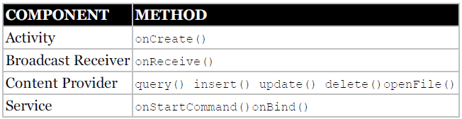
Essential Security Mechanisms
Review each entry point into application code that is accessible over the IPC sandbox.
Trace the functions that receive code from other apps inside each exported component.
Enforce permissions by setting the android: permission attribute in the manifest.

Slide 25


Essential …
Securing Activities
  Enforce secure communication
  Provide the right permissions
  Store private data within internal storage
  Keep services and dependencies up-to-date

Slide 26
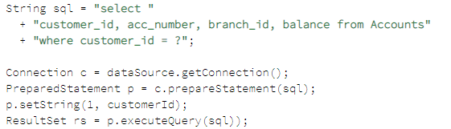
Essential …
Securing Content Providers
  Use android:exported=”false” so no other app can launch an activity.
  Avoid direct user input inside a SQL statement when using rawQuery() method in SQLite by concatenating queries.
    String[] userInput = new String[] {"book", "wiley"};
    Cursor c = database.rawQuery("SELECT * FROM Products WHERE type=?
    AND brand=?", userInput);
  Instead, use prepared statements.

Slide 27
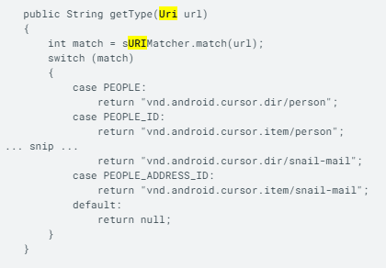
Essential …
Securing Content Providers …
  Prevent apps’ directory traversal attack by limiting to read only in app's data directory- use getCanonicalPath() method of the File class.
  Test if certain prefix is present when performing pattern-matching checks against a requested content URI.

Slide 28
Essential …
Securing Broadcast Receivers
  An attacker who knows your implemented secret code should not be able to have any control over the application.
  Secret codes should be used only for testing purposes and must be removed before releasing the application.
  Ensure that the code in the broadcast receiver cannot perform an unintended action by invoking the secret code.
  An app’s data storage must be done in a secure manner- sandbox is not enough to create a truly secure app in this context.

Slide 29
Essential …
Other secure measures:
  Creating secure files/folders like- FileOutputStream secretFile = openFileOutput("secret", Context.MODE_PRIVATE);
  When storing sensitive files on the SD card, it must be encrypted using appropriate Random Numbers, Key Generation, and Key Storage.
  Expose files securely when sending to other applications.
    Uri uri = Uri.parse("content://com.myapp.docs/document/1");
    Intent intent = new Intent(Intent.ACTION_VIEW);
    intent.setDataAndType(uri, "application/pdf");
    intent.setFlags(Intent.FLAG_ACTIVITY_NEW_TASK);
    intent.addFlags(Intent.FLAG_GRANT_READ_URI_PERMISSION);
    startActivity(intent);

Slide 30
Essential …
Creating Secure Communications
  Apply cryptographic security in Internet communications.
  Android has a rich set of APIs for local comm. between apps- so implementing same level of security for built-in APIs is hard.
  Limiting the attack surface when WebViews is used in an app- e.g., disable JavaScript if it is not required -webview.getSettings().setJavaScriptEnabled(false);

Slide 31
Essential …
Configuring the Android Manifest
  Some exploitations arise from a lack of understanding of configuration in the Android manifest.
  Prevent attacker having physical access by setting the: android:allowBackup and android:debuggable attributes to false.
  Logging can inadvertently expose information if it's left on in release builds, so use centralized logging class with flag.
  Reduce risk by limiting native code exposure to the outside world.

Slide 32
Slowing Down a Reverse Engineer
Compiled Android apps can easily be decompiled into readable source code.
So, security checks may only slow down a reverse engineer from analysing.
To make a reverse engineer's life more difficult, the use of obfuscators make decompiled code less readable and harder to follow.
Various code obfuscators exist- ProGuard, DashO, DexGuard, and Allatori.
Tamper Detection- An app can be designed to fail to run if it detects signs of modification of its APK file.
  E.g., a reverse engineer may have modified a manifest to include android:debuggable=”true”.

Slide 33
Discussion questions
What is the importance of finding vulnerabilities in pre-installed apps?
Why does a bug hunter place emphasis on gaining root access to a device?
How can some applications on a device have higher degree of power over the OS than others?
Which of the following an example powerful permission that can be granted to applications? a. INSTALL_PACKAGES b. RUN
ADB stands for: a. Android Drive Bridge b. Android Debug Bridge.
Remote attack vectors can enable exploiting apps in: a. server-side b. client-side
Which of the following are examples client-side exploits: a. browsers b. email clients
What happens if there is custom updating APK without SSL certificate?

Slide 34
Quiz
https://myandroid.site/android-developer-interview-questions/

Slide 35
Next topic
iOS: Security model; identification and analysis of security risks

